Slide 1
MEDICAL DATA HISTORY

Slide 2
Introduction
The Medical Data History project focuses on analysing the records of patients, their admissions, and the attending doctors. Using SQL, I performed a series of queries to extract valuable insights from the data, encompassing patient demographics, health conditions, and doctor-patient interactions. The analysis helped in understanding trends, patient characteristics, and identifying specific patterns in medical records.

Slide 3
Key Insights
1. Patient Demographics and Health Trends:
The database contains a mix of male and female patients, with a clear breakdown of gender distribution. A targeted query revealed that the number of male and female patients is relatively balanced, helping to understand the diversity of the patient base.
The most common allergies among patients were identified, providing insights into the medical conditions that are prevalent among the population. This analysis could help doctors better prepare for common allergic reactions.
Unique cities within the 'NS' province where patients reside were listed, which could assist in region-specific healthcare planning and resource allocation.
Patients born in the 1970s were analysed, sorted by birth dates, providing a snapshot of middle-aged demographics that may require targeted medical attention.

Slide 4
2. Medical Conditions and Diagnoses
A significant focus was placed on patients with specific diagnoses like 'Dementia' and 'Epilepsy'. The data revealed patients' details along with their attending doctors’ specialties, emphasizing the role of specialized care.
Patients with multiple admissions for the same diagnosis were highlighted, which can help identify chronic conditions that require ongoing medical care and management.
The analysis of admissions occurring on the same day provided insights into short-term medical cases and emergency care trends, potentially informing hospital management about resource allocation needs.
3. Physical Attributes and Health Indicators
Queries grouped patients based on their weight ranges, providing a clear understanding of different weight categories. This data can inform health initiatives aimed at addressing issues like obesity or malnutrition.
The calculation of obesity status using BMI (Body Mass Index) highlighted the proportion of the patient population that might be at risk due to high BMI values.
The analysis of patient height ranges across different provinces helped identify variations in physical attributes across regions.

Slide 5
4. Access to Medical Records and Security:
A special focus was placed on patients who have gone through the admissions process, as they were assigned temporary passwords for accessing their medical documents. The passwords were created using a combination of the patient's ID, the length of their last name, and their birth year, ensuring a secure and personalized access system.
The analysis included listing patients who were given access to their records, enhancing transparency and security within the medical records management system.
5. Data Integrity and Updates:
The project required updating certain data fields, such as replacing `NULL` values in the `allergies` column with 'NKA' (No Known Allergies). This step ensured that the data remains consistent and meaningful for further analysis.
Renaming the `attending_doctor_id` column to `doctor_id` in the `admissions` table enabled smoother data merging, facilitating more accurate joins and queries.

Slide 6
Conclusion:
The Medical Data History project provided an in-depth analysis of patient and medical data through a series of SQL queries. The insights derived from the data can help medical professionals, hospital administrators, and healthcare planners make informed decisions regarding patient care, resource management, and health monitoring. By understanding patient demographics, common health conditions, and region-specific data, the project lays the foundation for better healthcare services and a more personalized approach to patient management

Slide 7
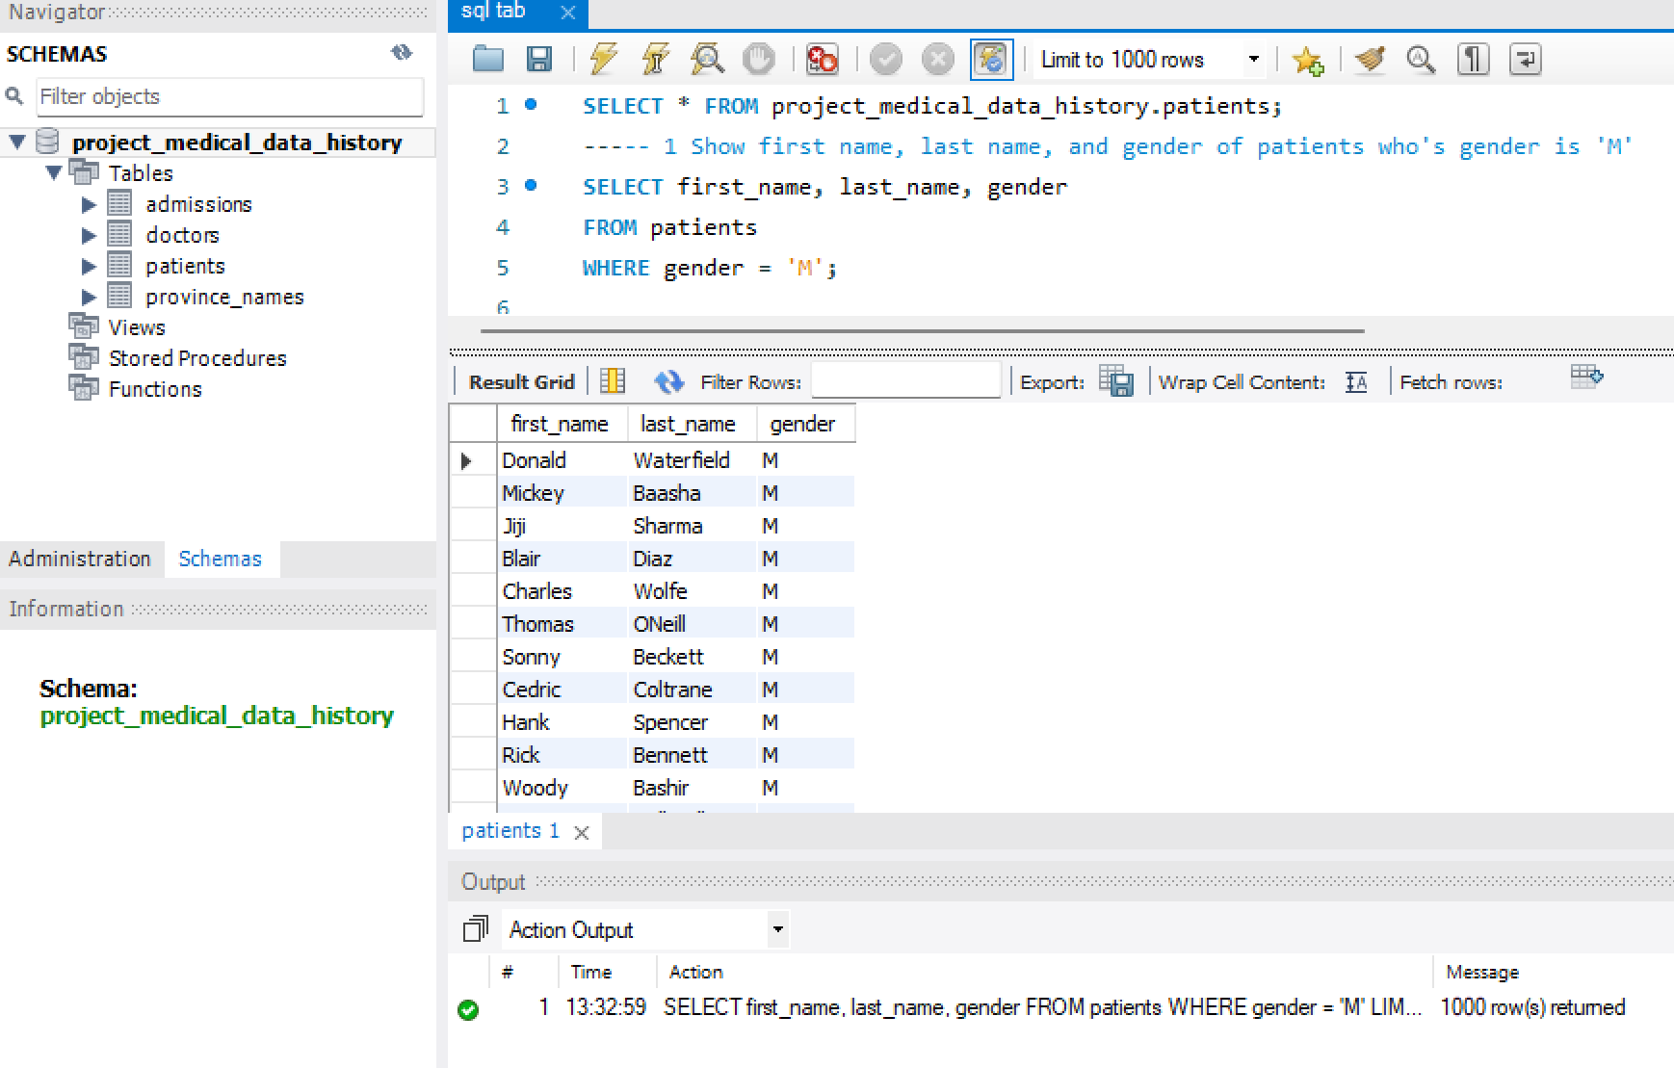
Key Insights
1 . Show first name, last name, and gender of patients who's gender is 'M'

Slide 8
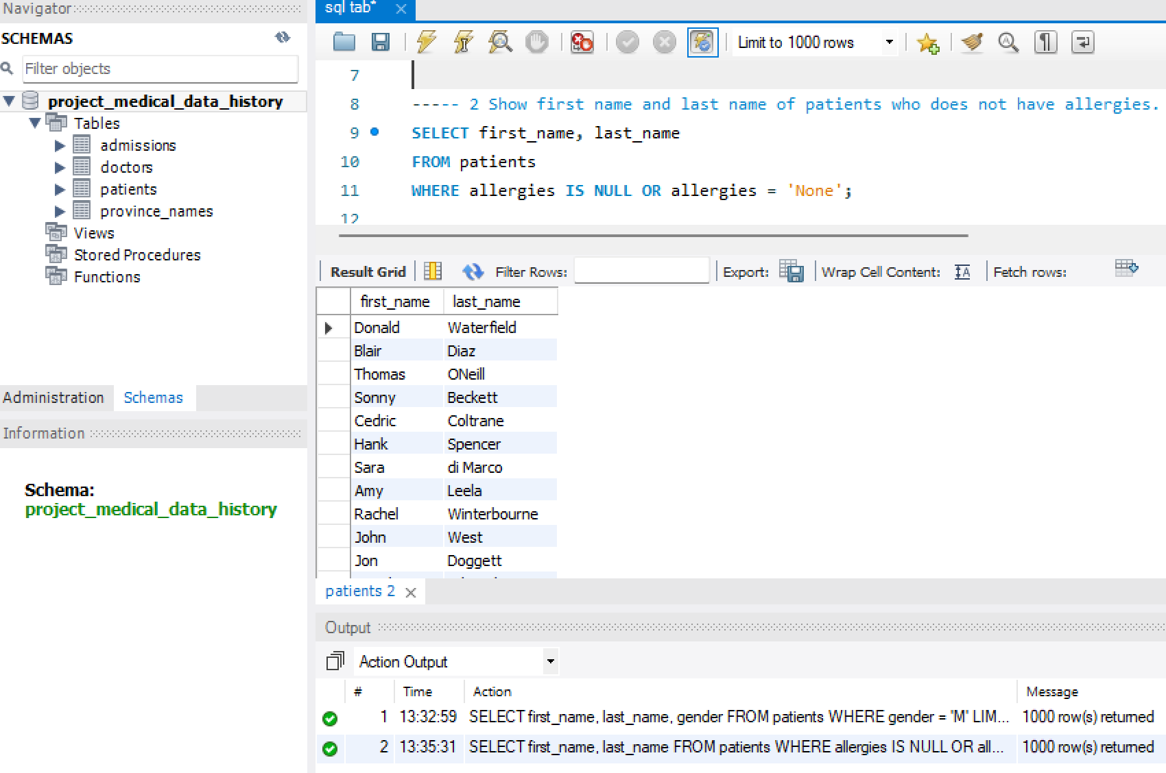
.
2 Show first name and last name of patients who does not have allergies

Slide 9
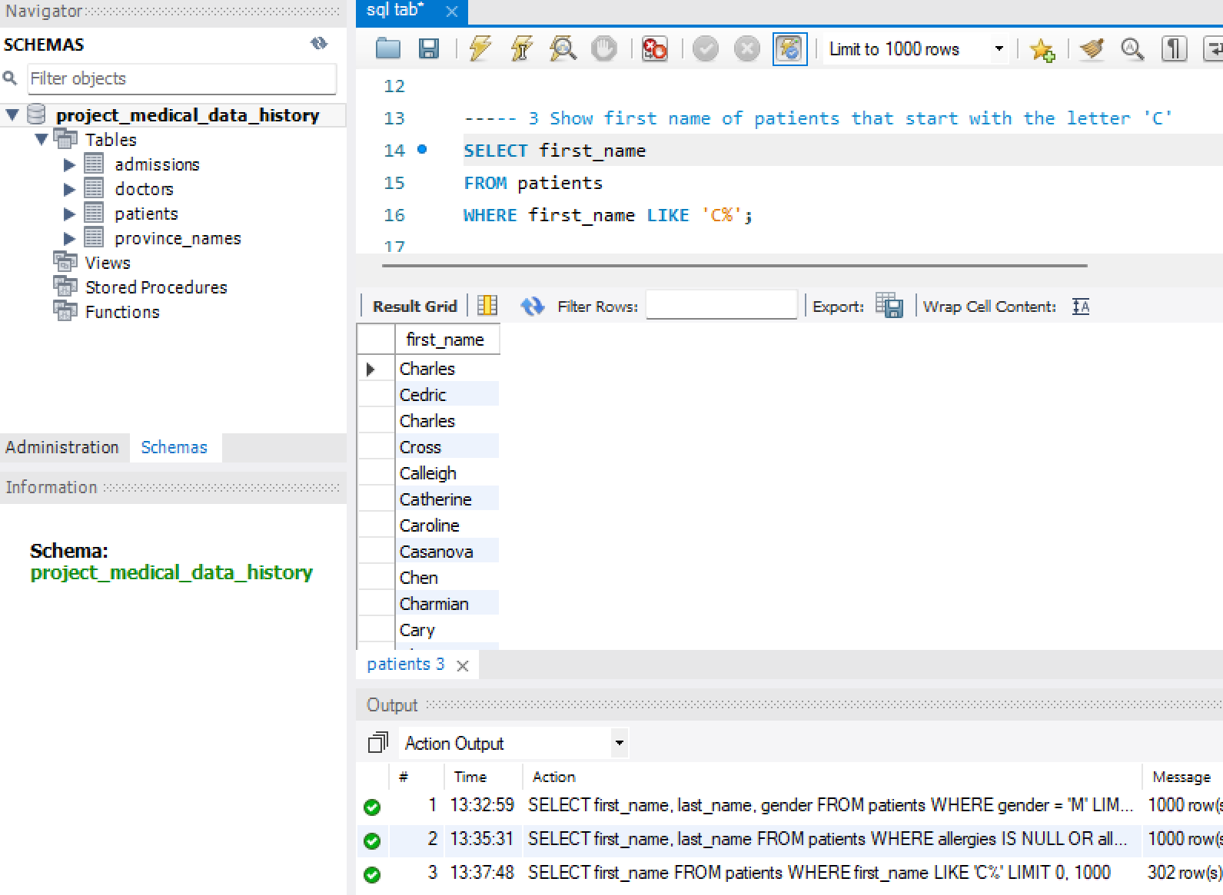
3 Show first name of patients that start with the letter 'C'

Slide 10
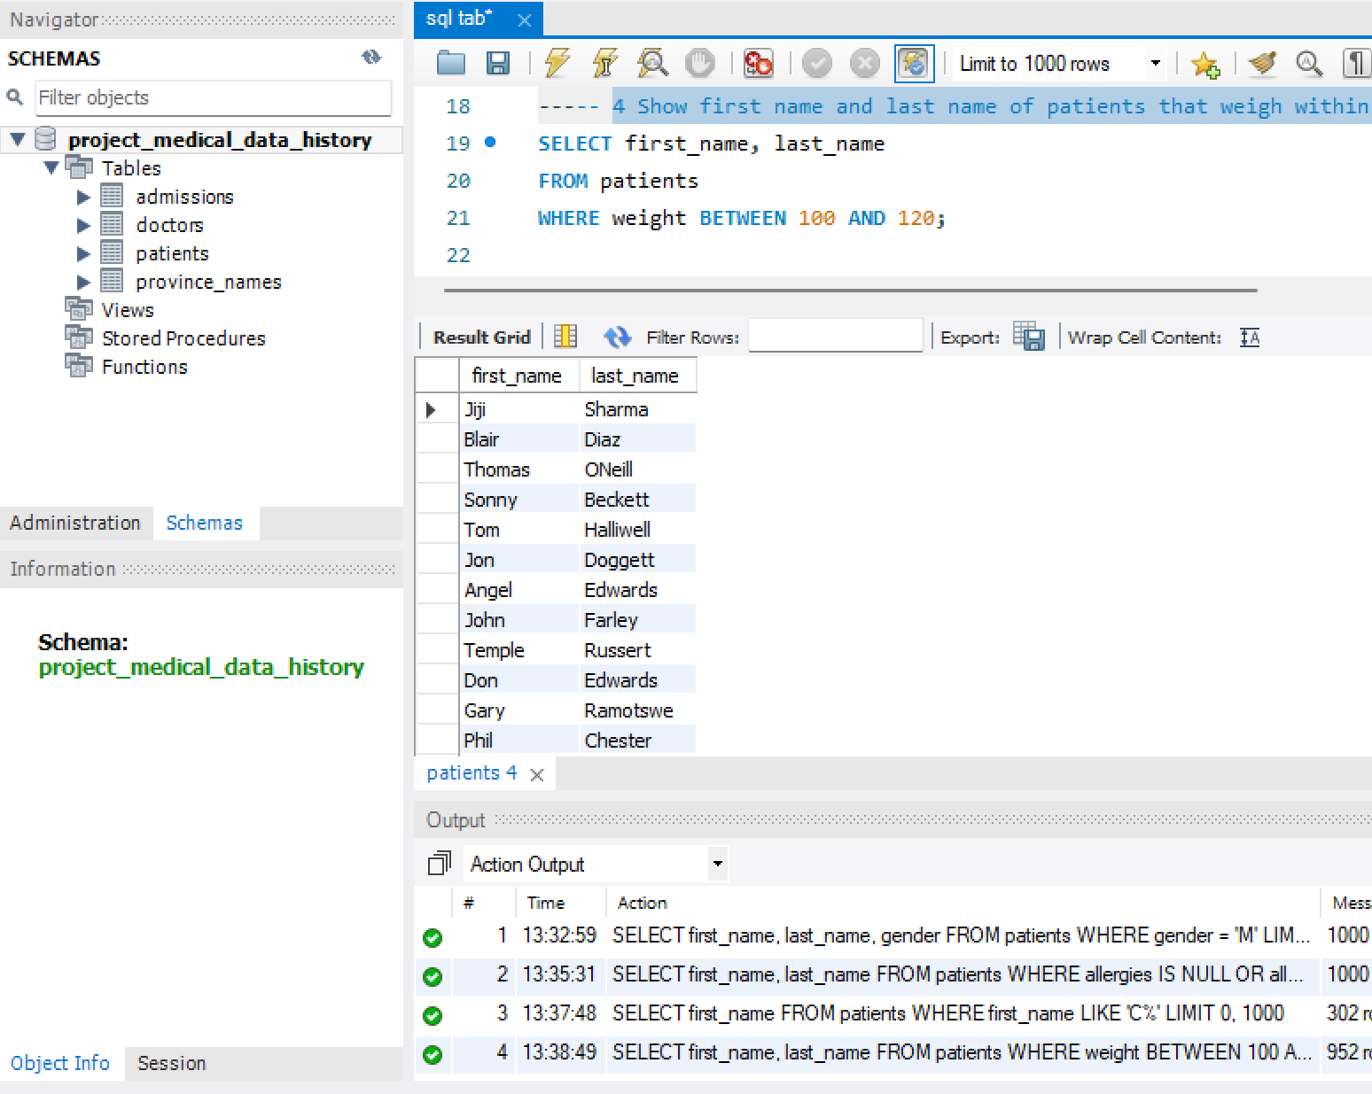
4 Show first name and last name of patients that weigh within the range of 100 to 120 (inclusive)

Slide 11
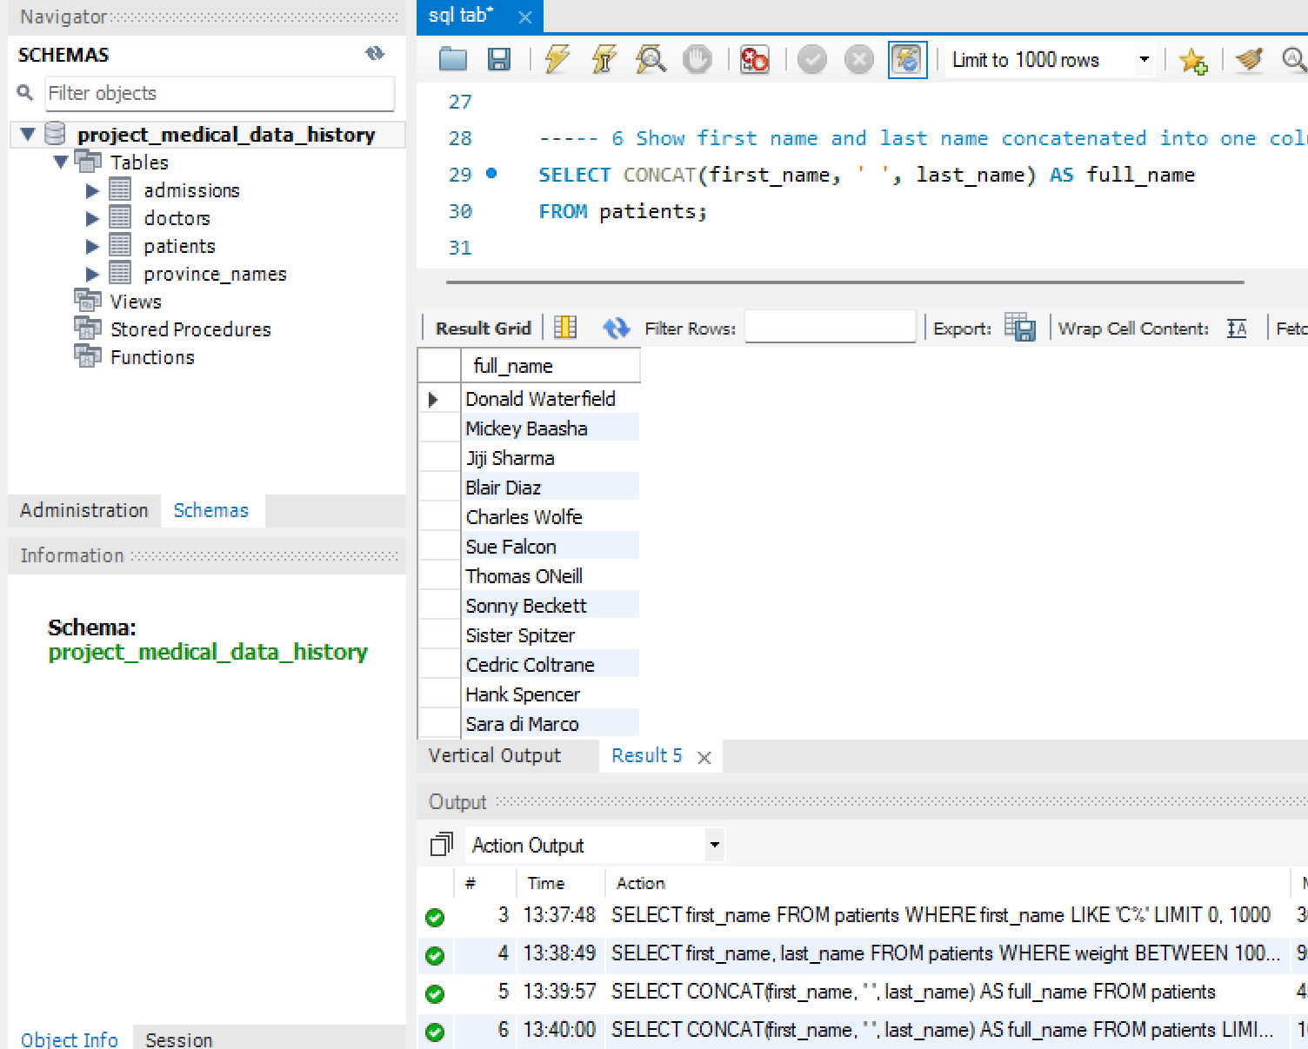
6 Show first name and last name concatenated into one column to show their full name.

Slide 12
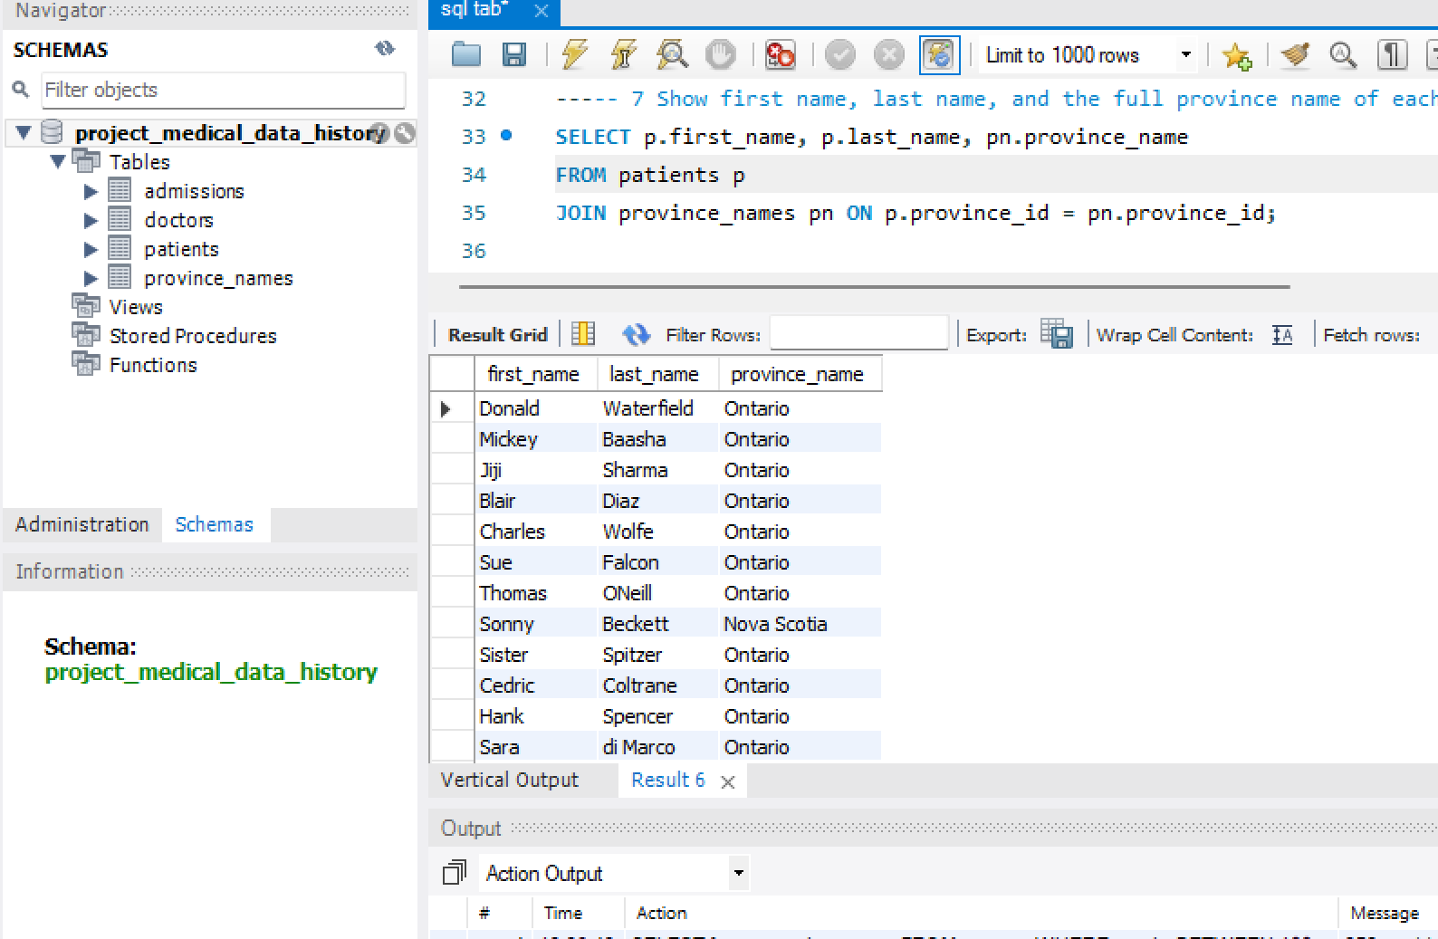
7 Show first name, last name, and the full province name of each patient.

Slide 13
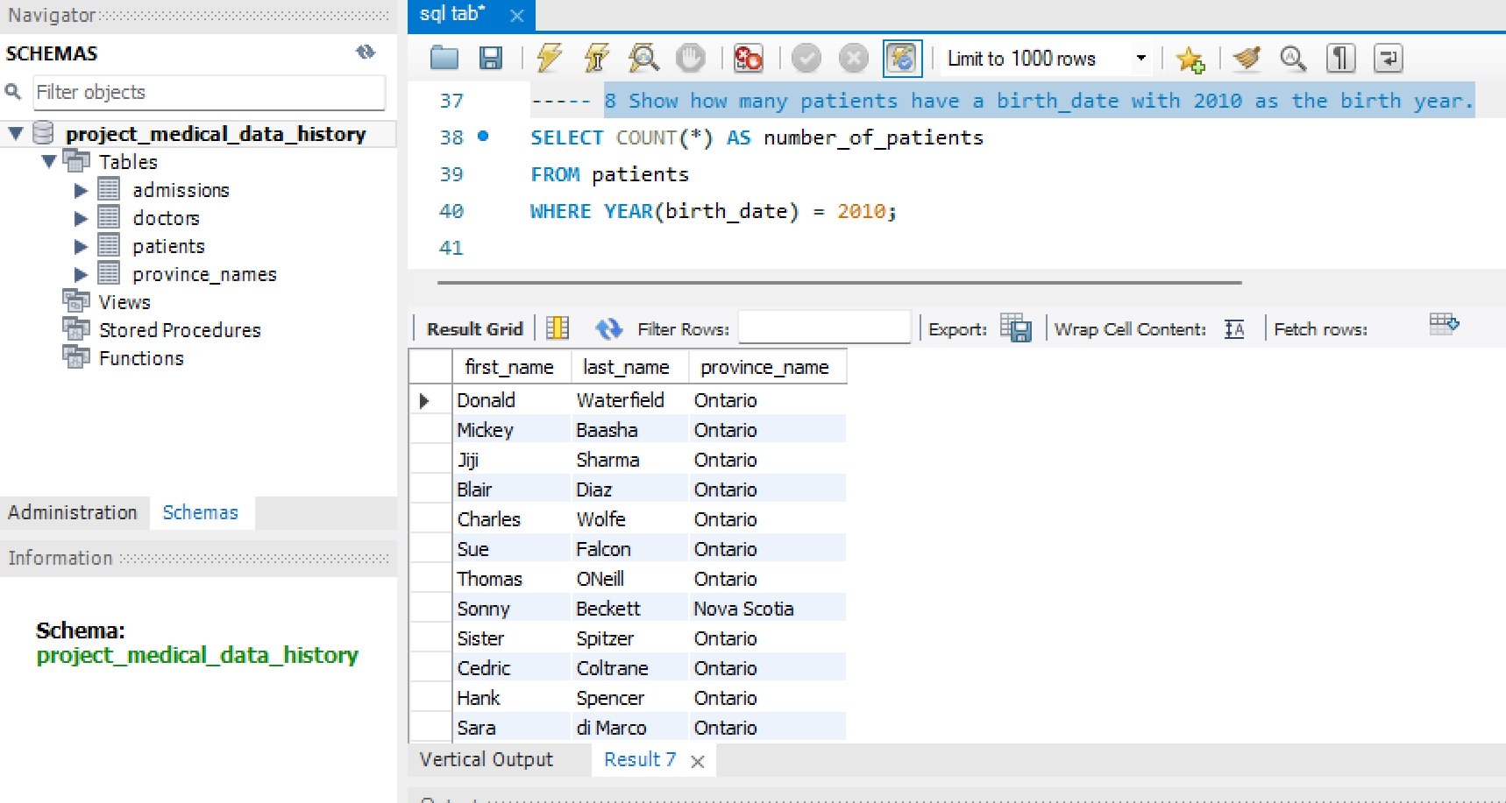
8 Show how many patients have a birth_date with 2010 as the birth year.

Slide 14
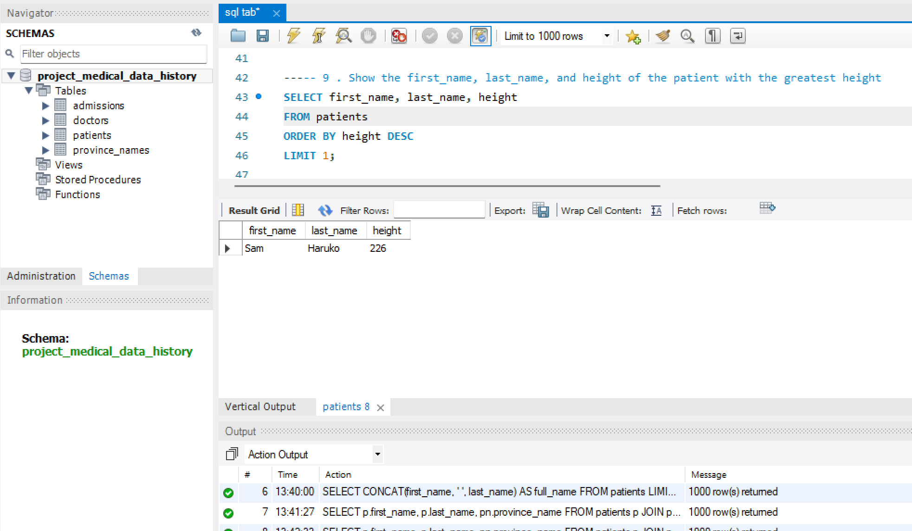
9 . Show the first_name, last_name, and height of the patient with the greatest height

Slide 15
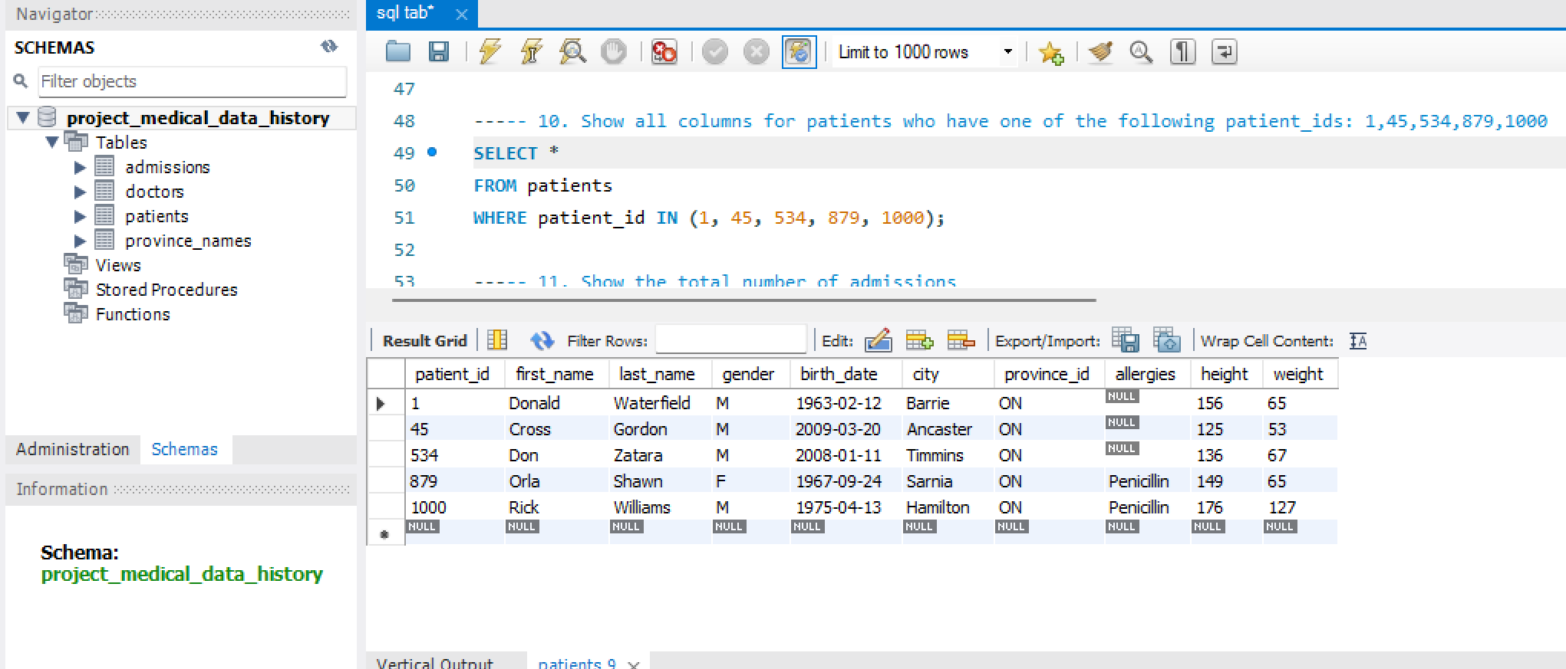
10. Show all columns for patients who have one of the following patient_ids: 1,45,534,879,1000

Slide 16
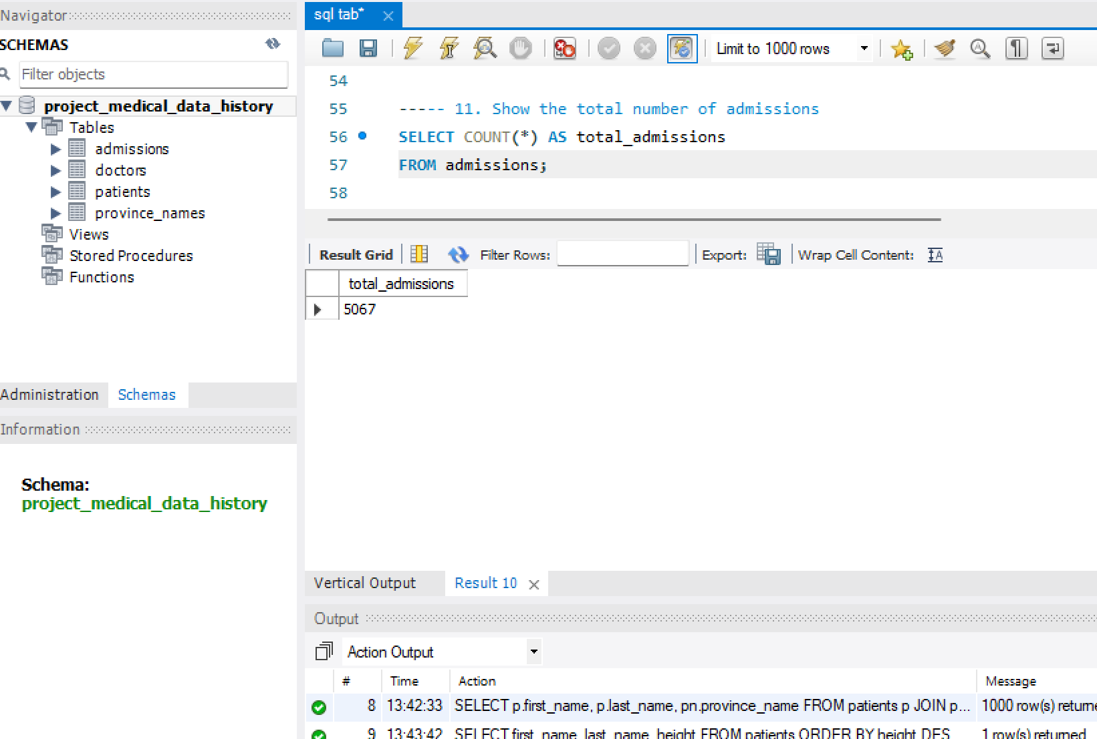
11. Show the total number of admissions

Slide 17
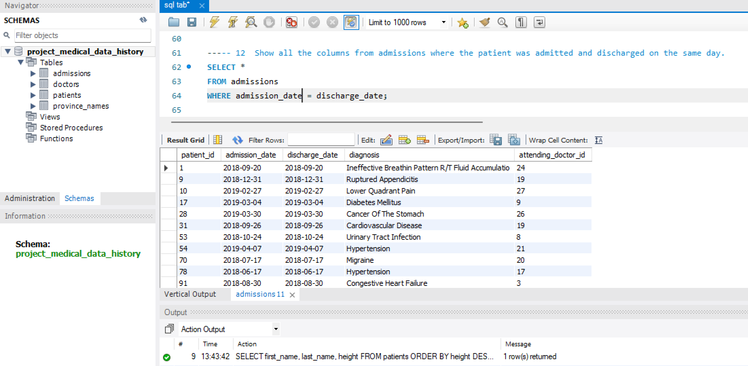
12 Show all the columns from admissions where the patient was admitted and discharged on the same day .

Slide 18
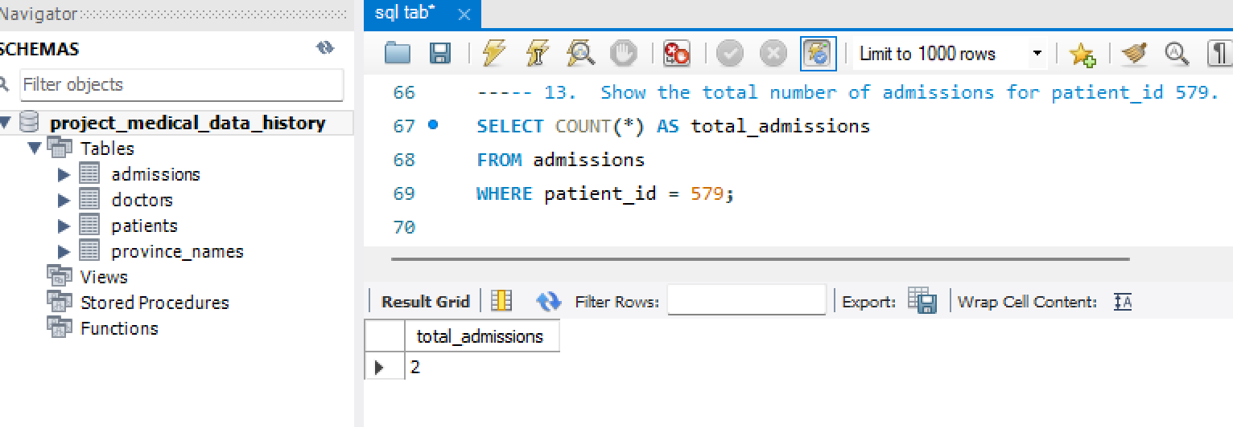
13. Show the total number of admissions for patient_id 579.

Slide 19
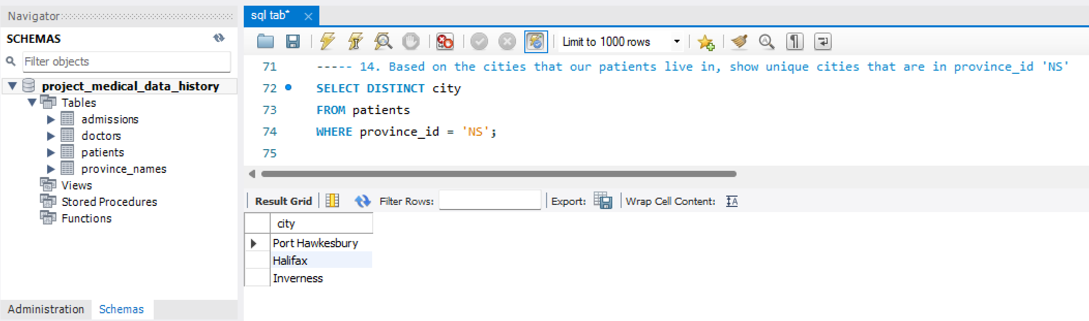
14. Based on the cities that our patients live in, show unique cities that are in province_id 'NS'

Slide 20
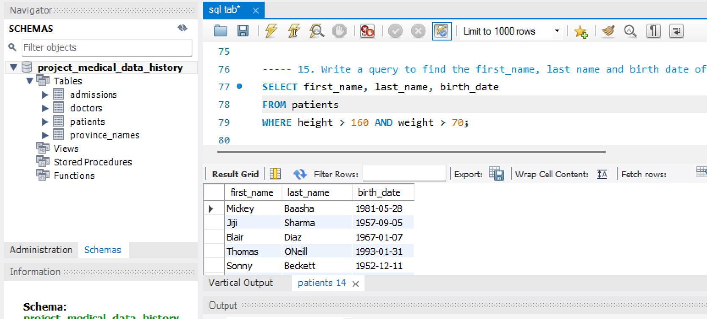
15. Write a query to find the first_name, last name and birth date of patients who have height more than 160 and weight more than 70

Slide 21
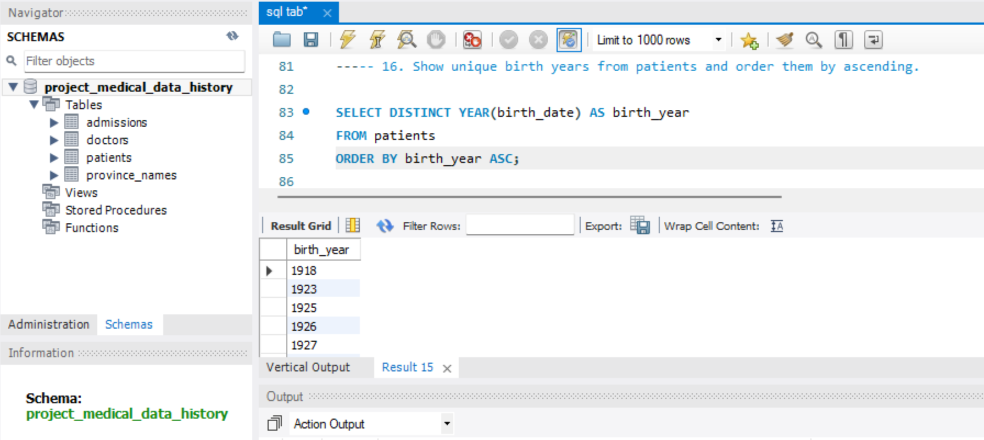
16. Show unique birth years from patients and order them by ascending.

Slide 22
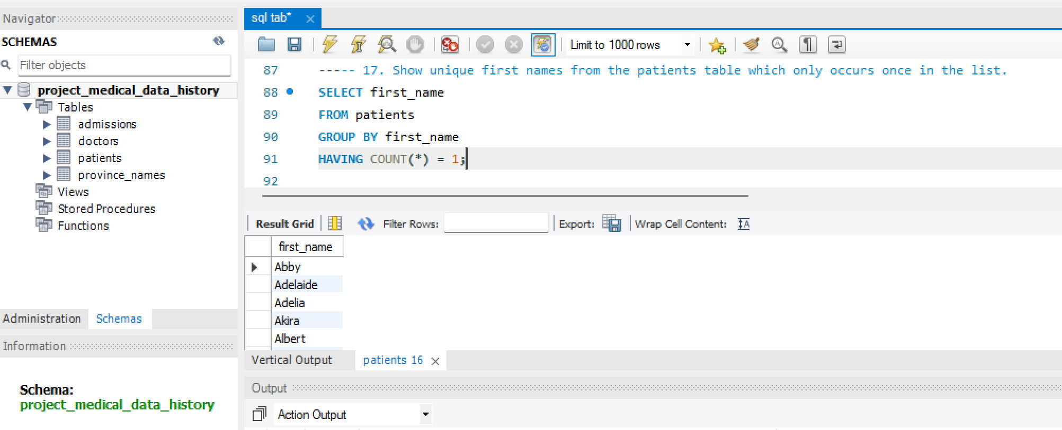
17. Show unique first names from the patients table which only occurs once in the list.

Slide 23
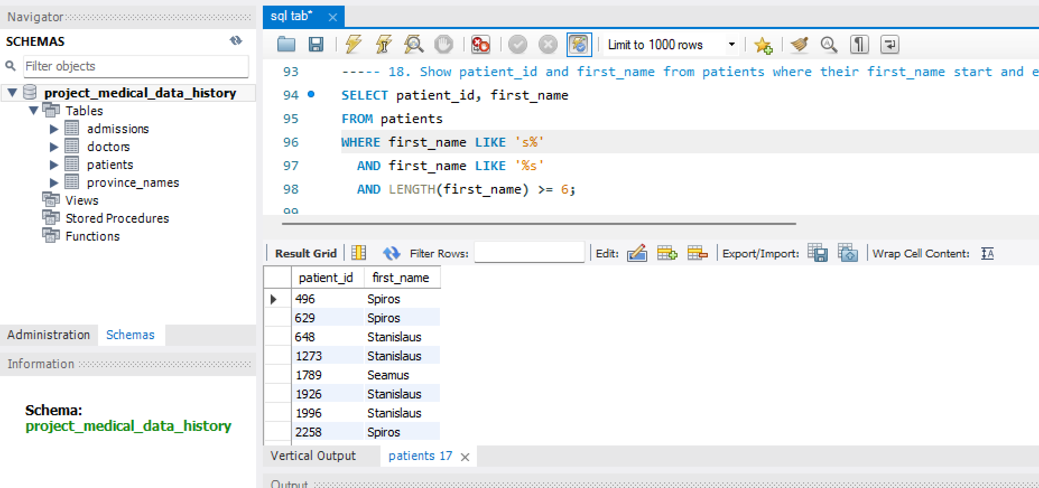
18. Show patient_id and first_name from patients where their first_name start and ends with 's' and is at least 6 characters long.

Slide 24
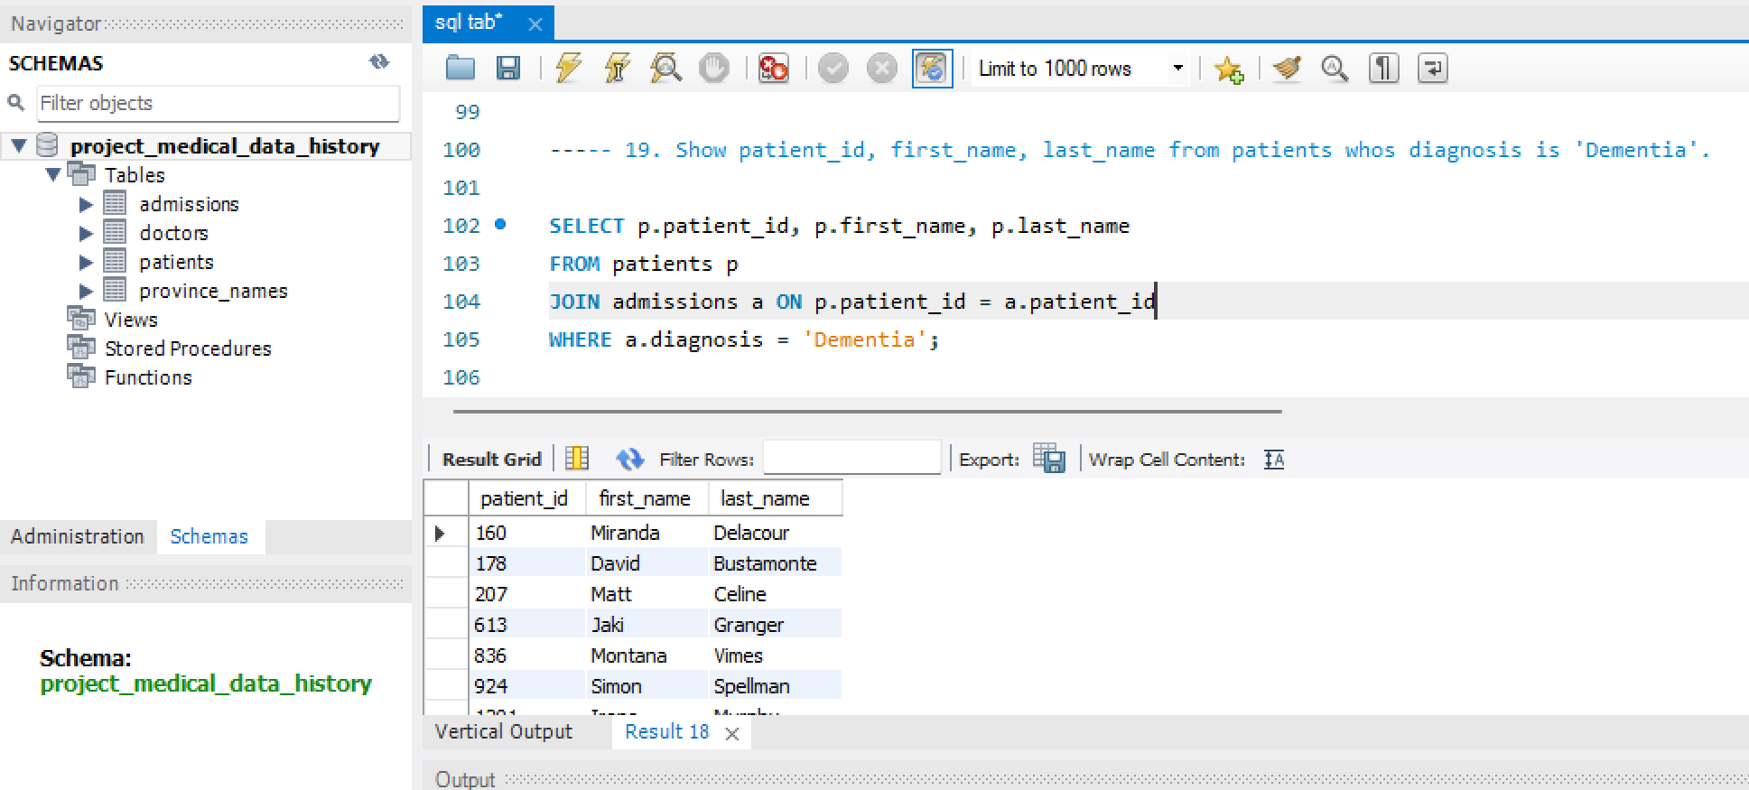
19. Show patient_id, first_name, last_name from patients whos diagnosis is 'Dementia'.

Slide 25
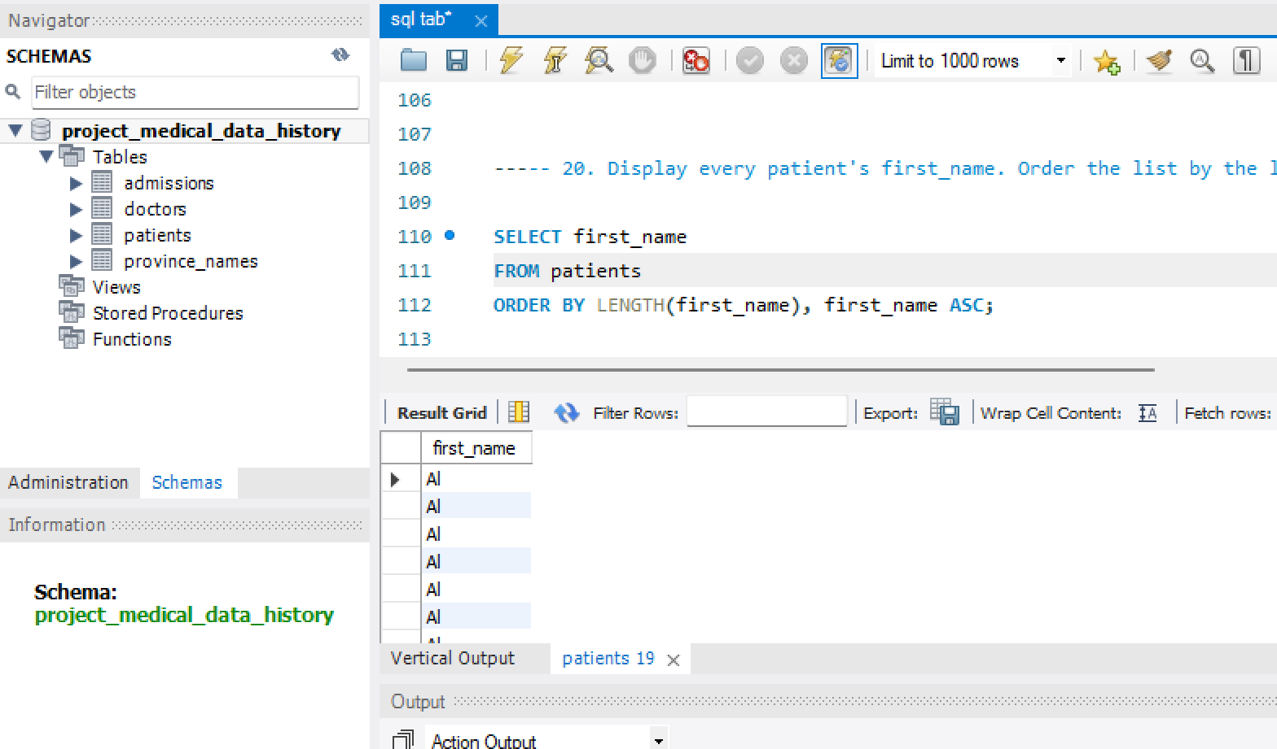
20. Display every patient's first_name. Order the list by the length of each name and then by alphbetically.

Slide 26
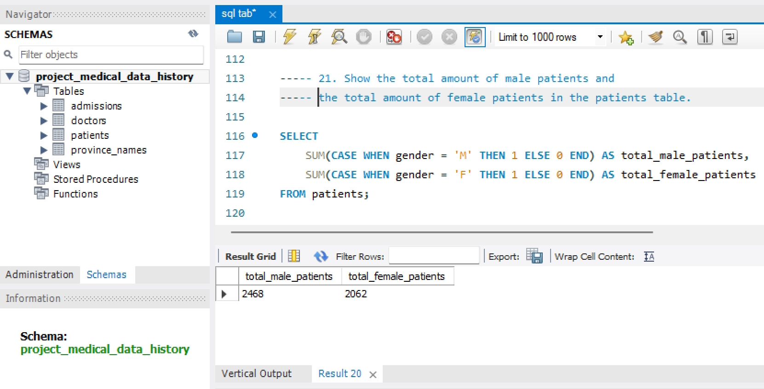
21. Show the total amount of male patients and the total amount of female patients in the patients table.

Slide 27
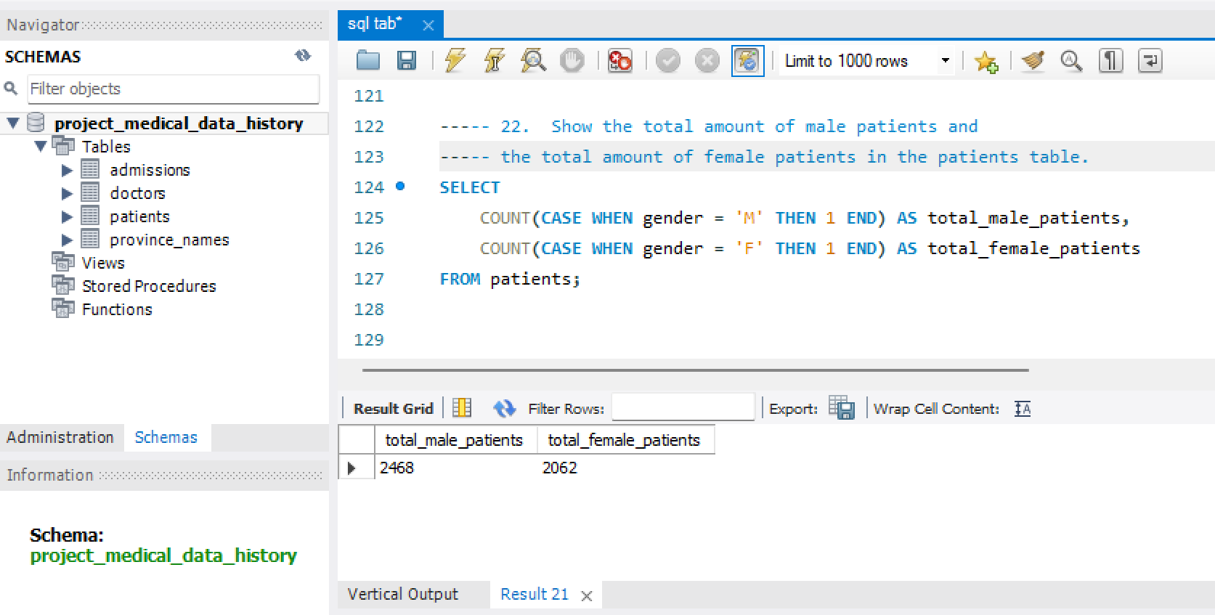
22. Show the total amount of male patients and the total amount of female patients in the patients table.

Slide 28
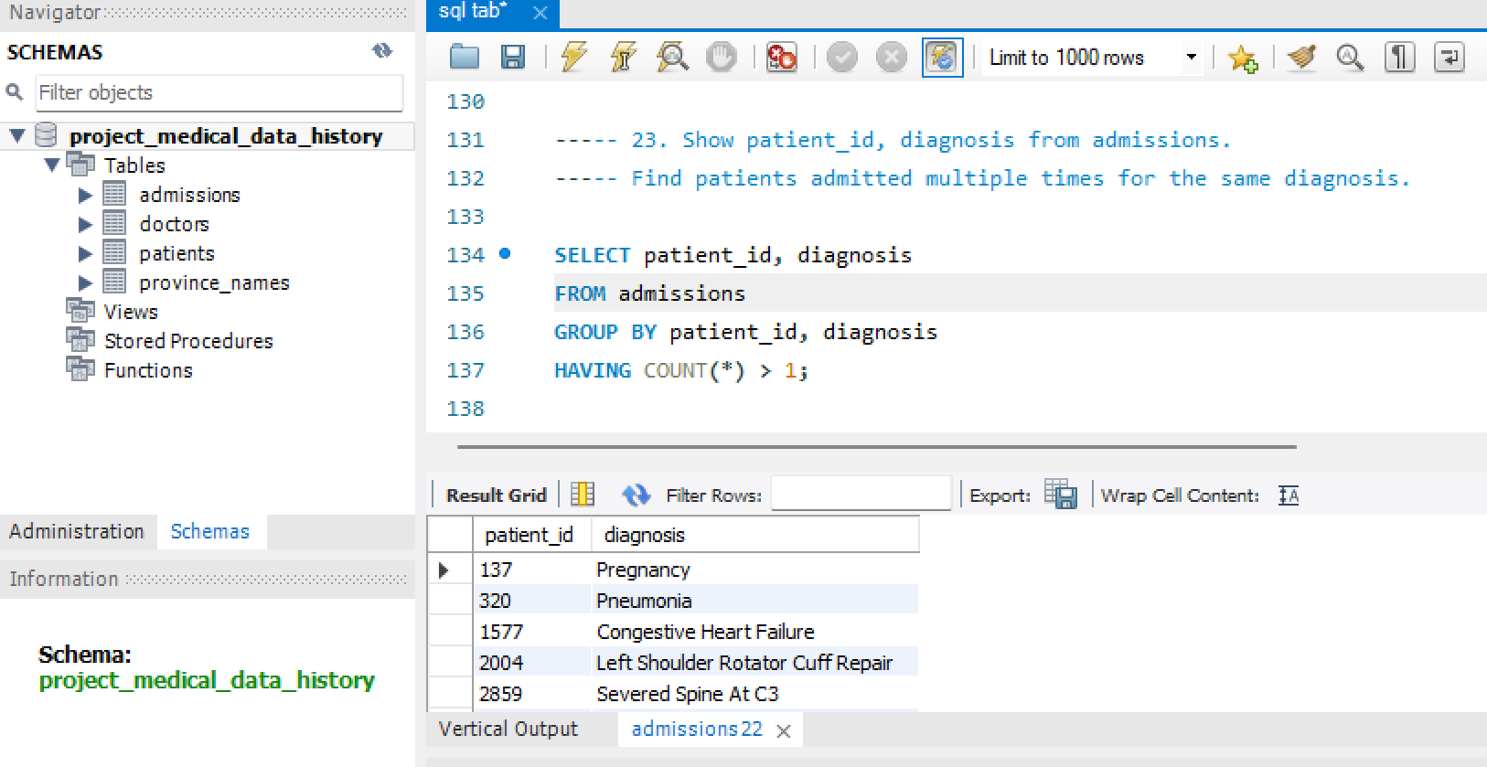
23. Show patient_id, diagnosis from admissions. Find patients admitted multiple times for the same diagnosis.

Slide 29
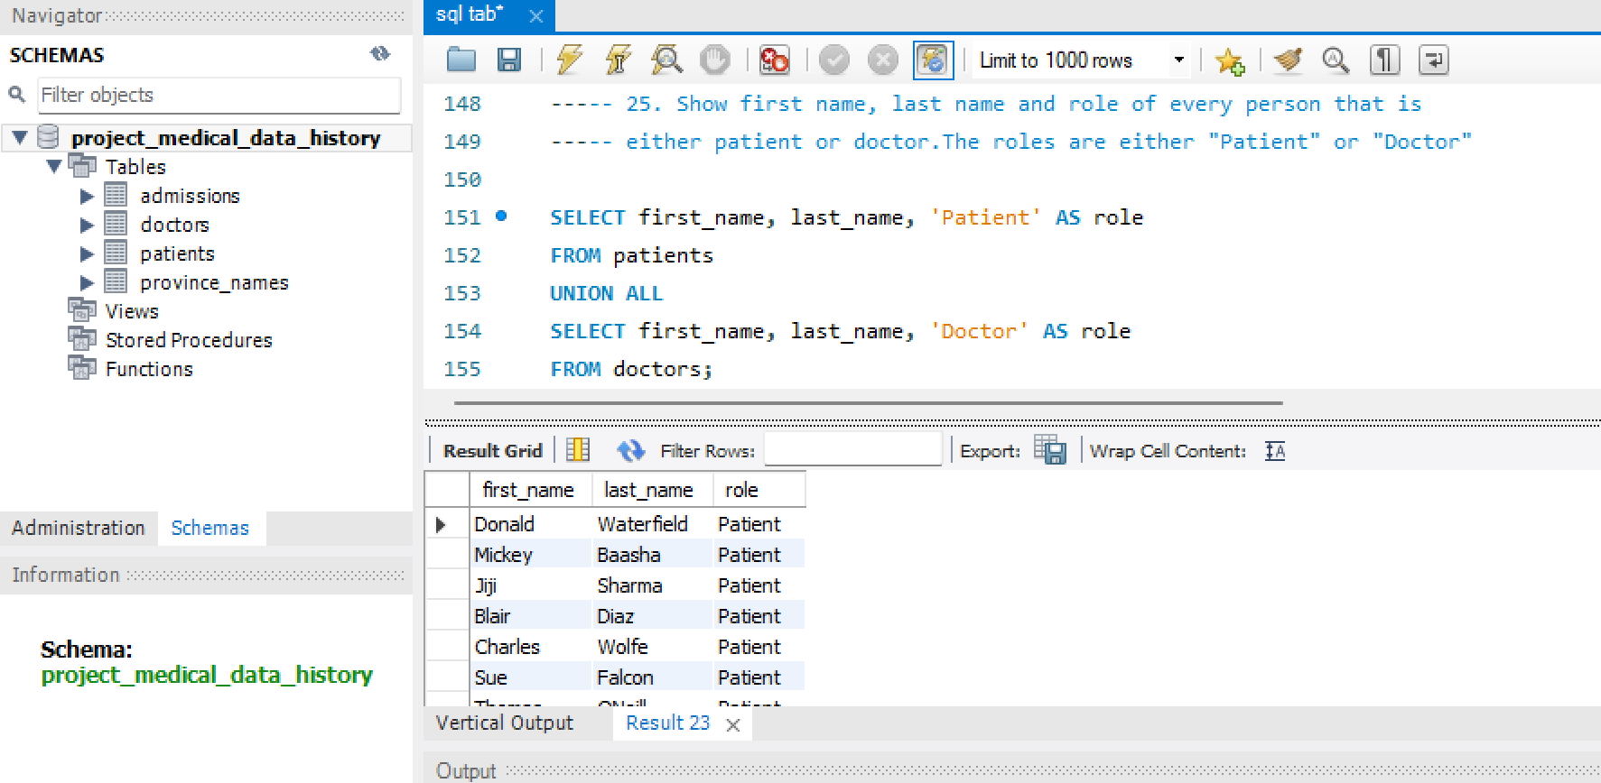
25. Show first name, last name and role of every person that is either patient or doctor.The roles are either "Patient" or "Doctor"

Slide 30
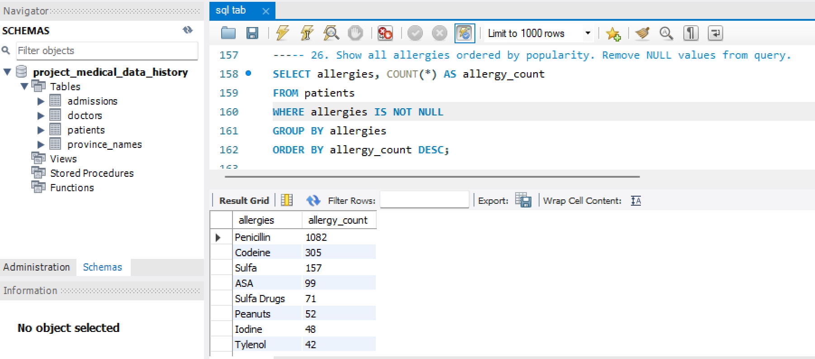
26. Show all allergies ordered by popularity. Remove NULL values from query.

Slide 31
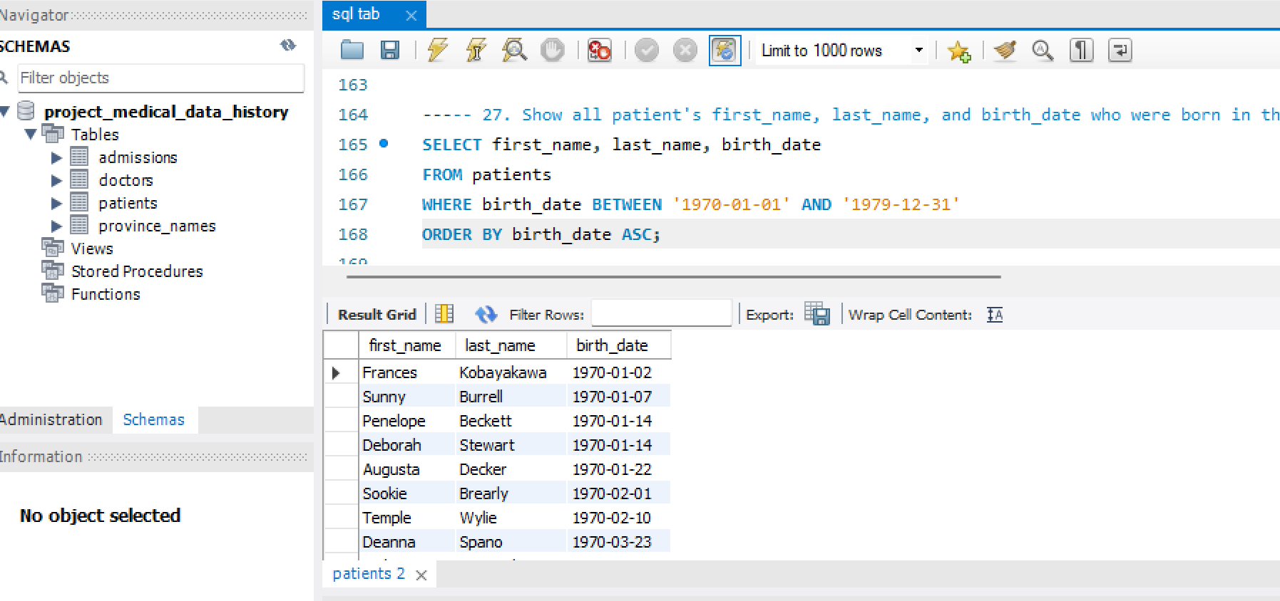
27. Show all patient's first_name, last_name, and birth_date who were born in the 1970s decade. Sort the list starting from the earliest birth_date.

Slide 32
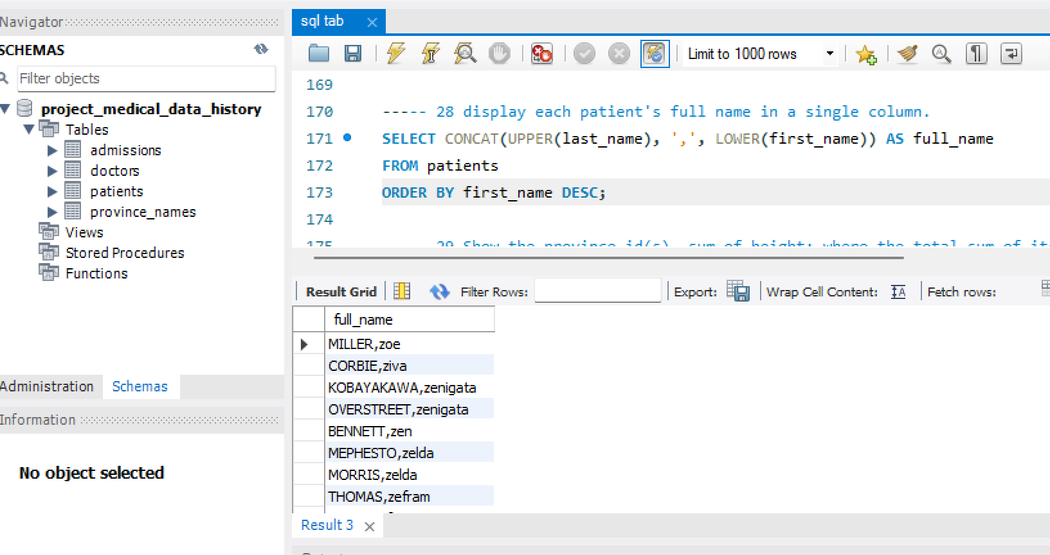
28 display each patient's full name in a single column.

Slide 33
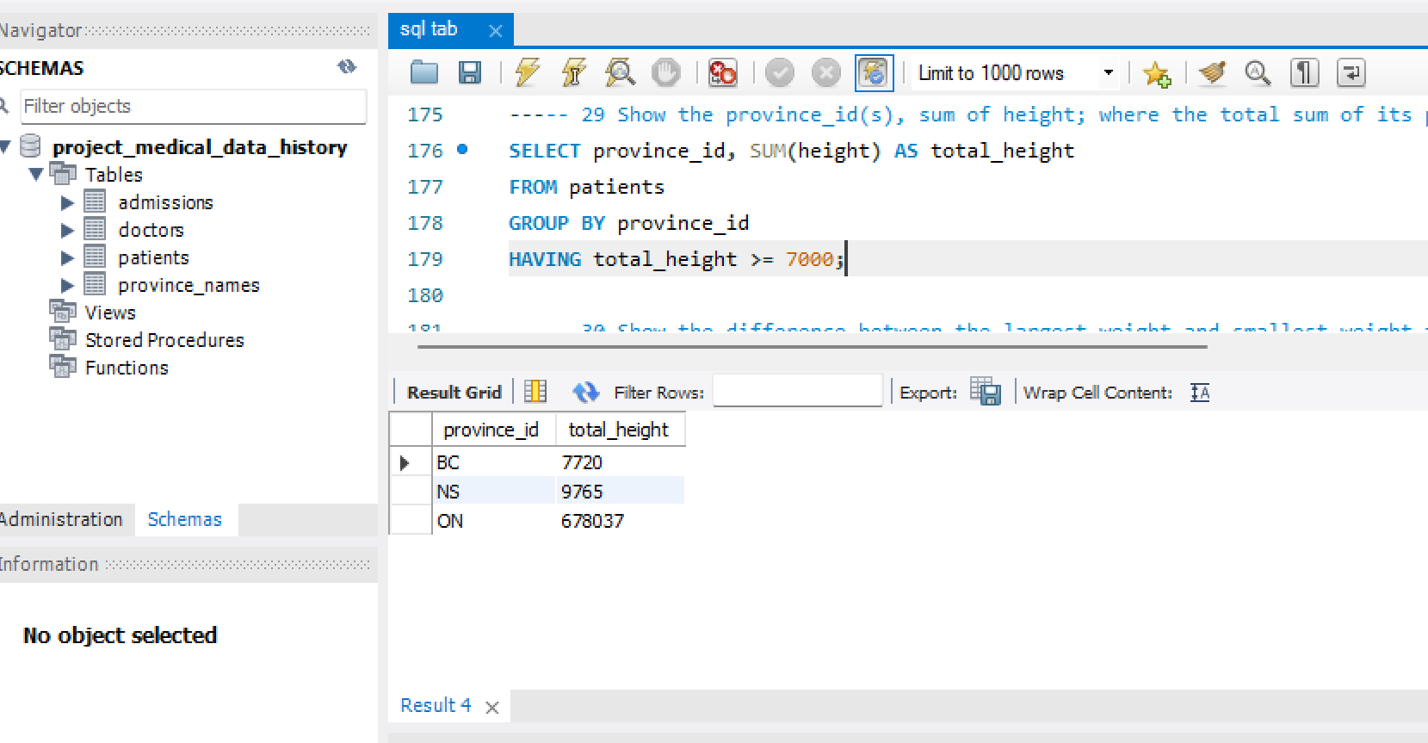
29 Show the province_id(s), sum of height; where the total sum of its patient's height is greater than or equal to 7,000.

Slide 34
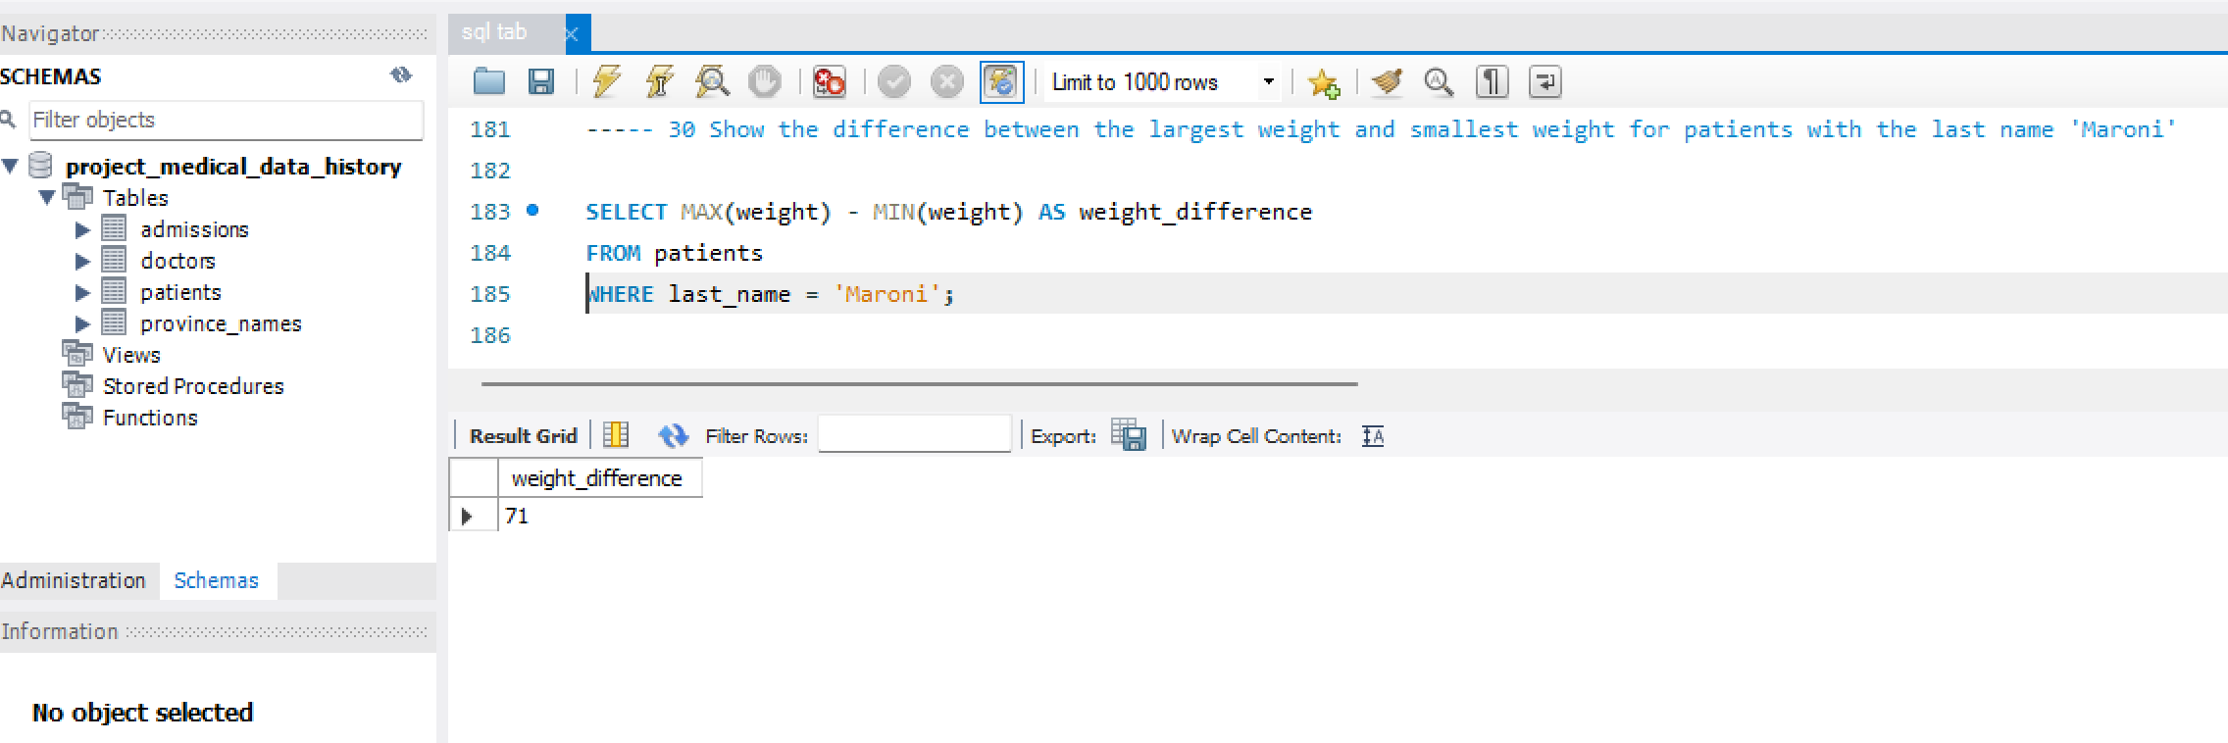
30 Show the difference between the largest weight and smallest weight for patients with the last name 'Maroni'

Slide 35
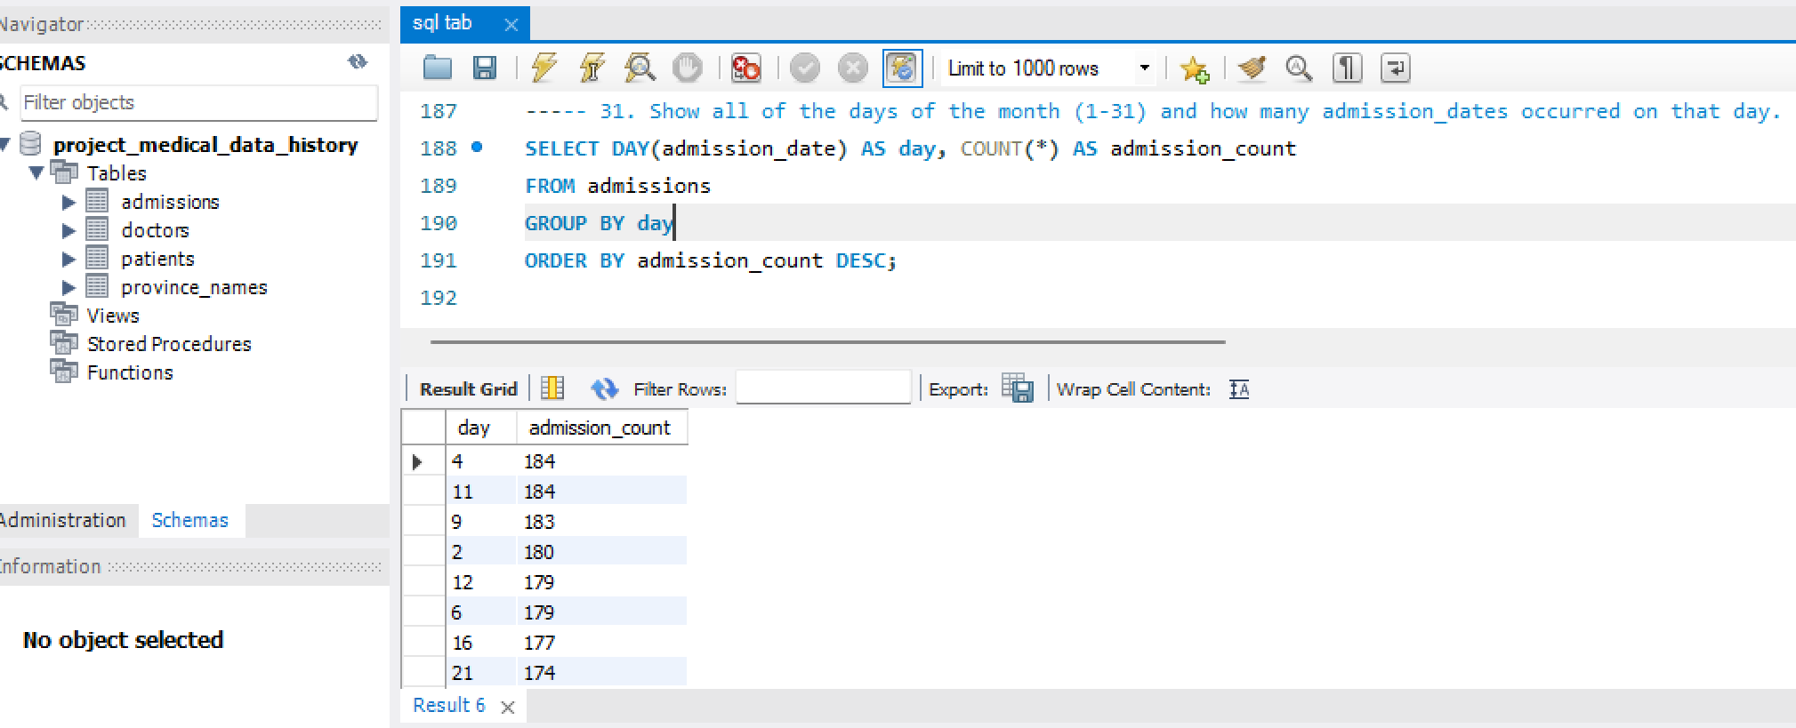
31. Show all of the days of the month (1-31) and how many admission_dates occurred on that day.

Slide 36
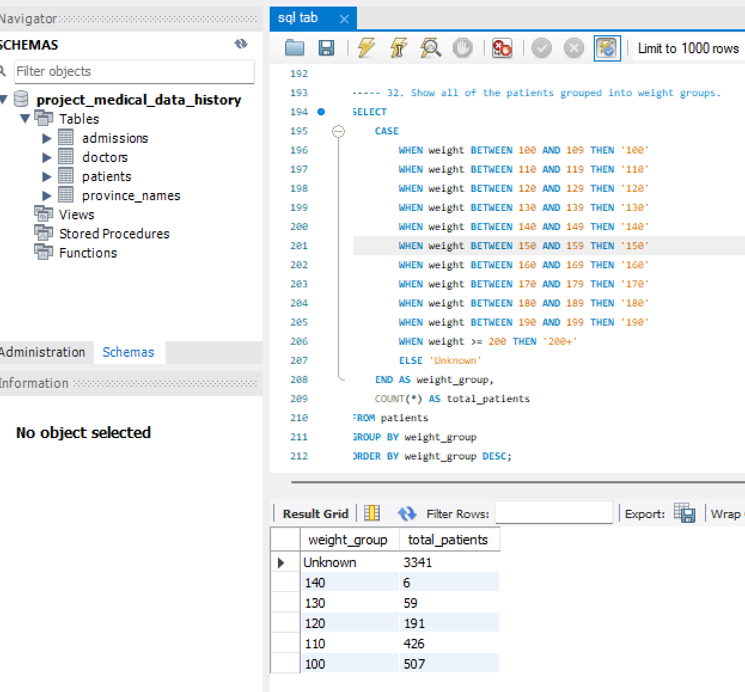
32. Show all of the patients grouped into weight groups.

Slide 37
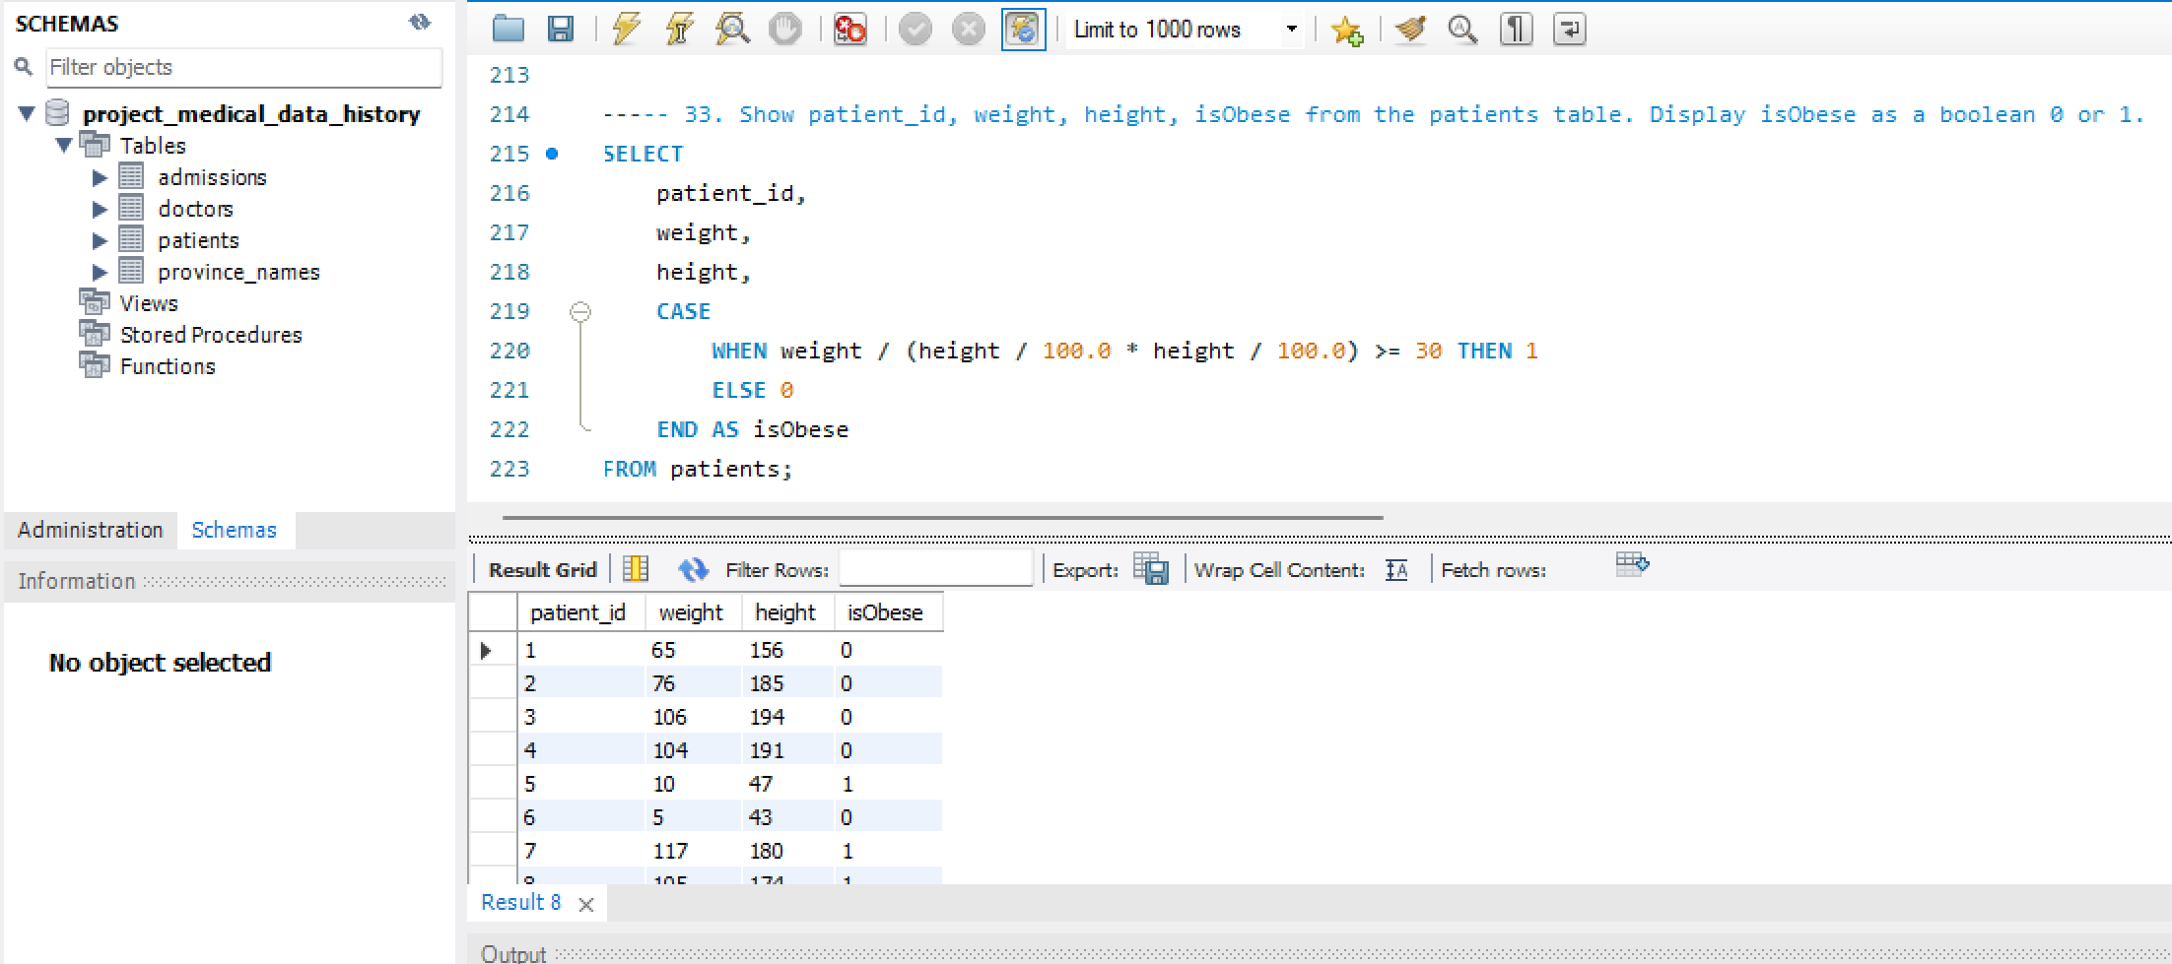
33. Show patient_id, weight, height, isObese from the patients table. Display isObese as a boolean 0 or 1.

Slide 38
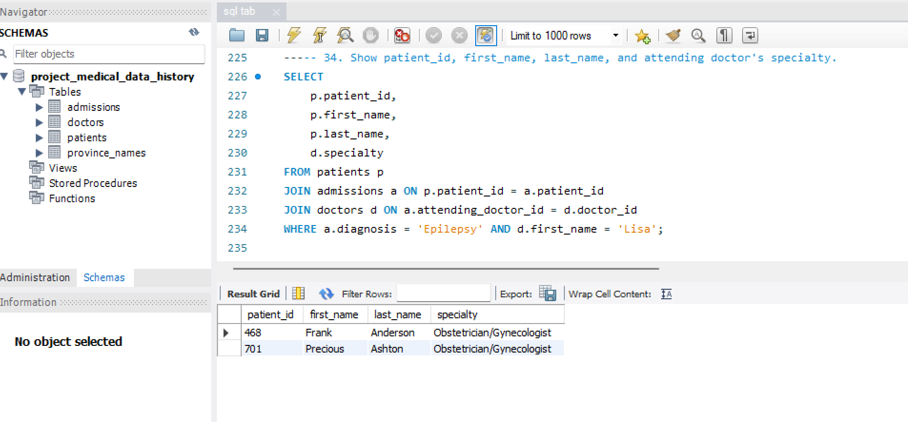
34. Show patient_id, first_name, last_name, and attending doctor's specialty.

Slide 39
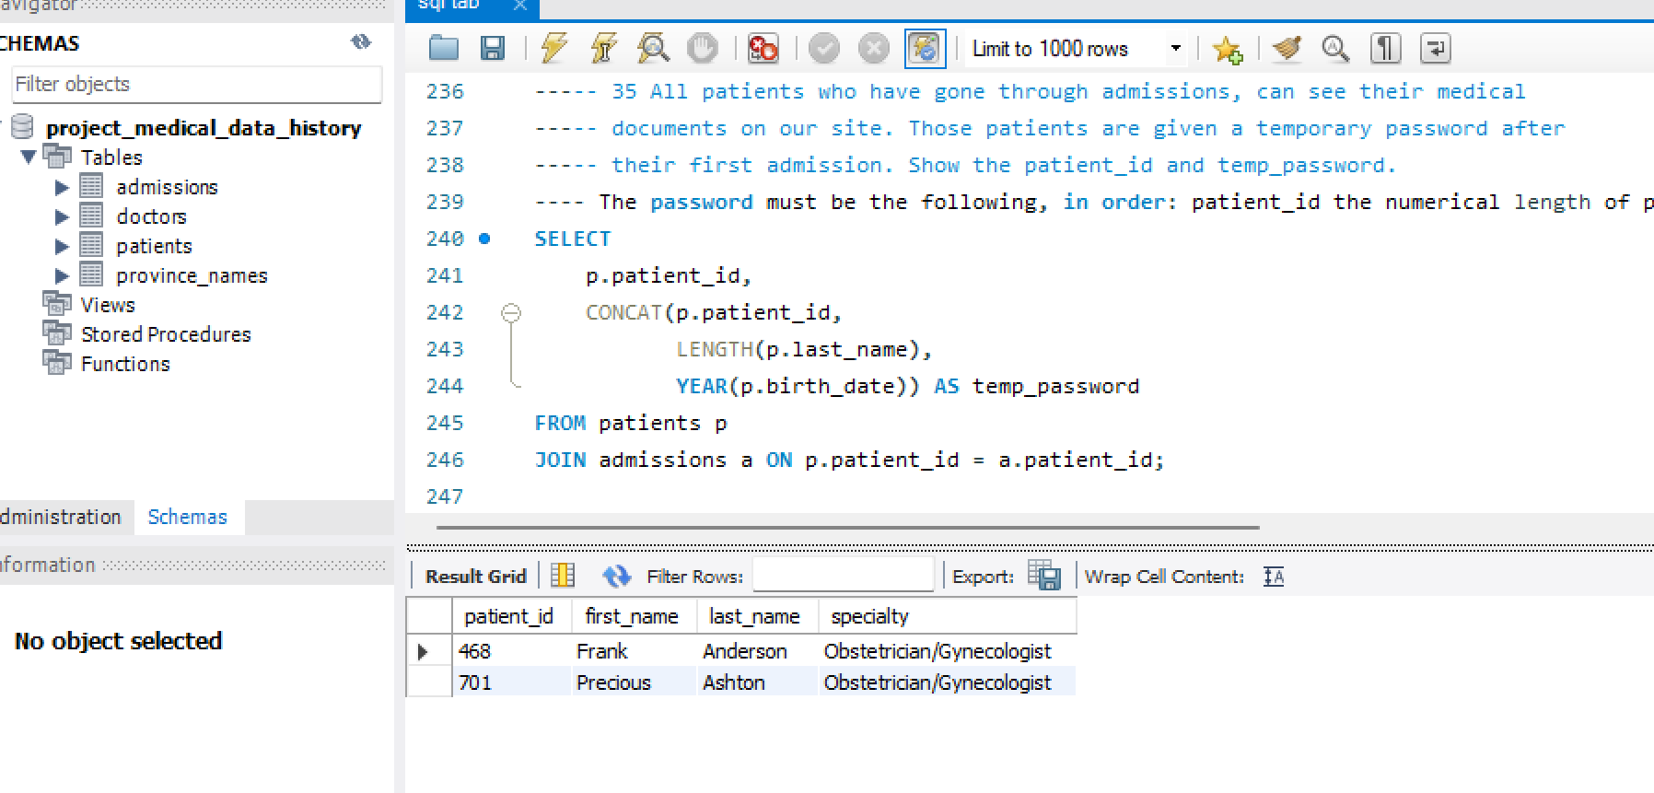
35. All patients who have gone through admissions, can see their medical documents on our site. Those patients are given a temporary password after their first admission. Show the patient_id and temp_password.
The password must be the following, in order:
- patient_id
- the numerical length of patient's last_name
- year of patient's birth_date

Slide 40
Insights and Suggestions
The analysis of the Medical Data History revealed key trends, such as the balanced gender distribution among patients and common allergies like 'NKA' (No Known Allergies). Understanding the demographics, such as patients born in the 1970s and those with specific diagnoses like 'Epilepsy', can help tailor targeted healthcare services. Grouping patients by weight ranges highlighted the need for obesity management. Moreover, tracking repeated admissions for chronic conditions could improve patient care. It is suggested that hospitals utilize these insights for better resource allocation, personalized care plans, and enhanced patient engagement through secure access to medical records.

